Slide 1

https://sahibulsaif.wordpress.com/wisdom/bismillah-nature/

Slide 2
FILE BASED SYSTEMS
CSC271 – DATABASE SYSTEMS
LECTURE - 02

Slide 3
Previous Lecture Overview

Slide 4
Today’s Lecture
In this lecture, you will learn about:
Data files
File based systems
Limitations of File based systems

Slide 5
Definitions
Data: Meaningful facts, text, graphics, images, sound, video segments
Information: Data processed to be useful in decision making
Metadata: Data that describes data

Slide 6
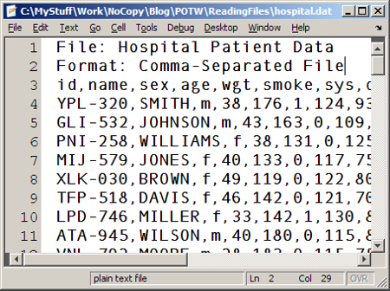
Data Files
A file is a collection of related information
Each data file is a sequence of records
Each file has a specific format
http://blogs.mathworks.com/pick/2008/06/06/reading-formatted-text/

Slide 7
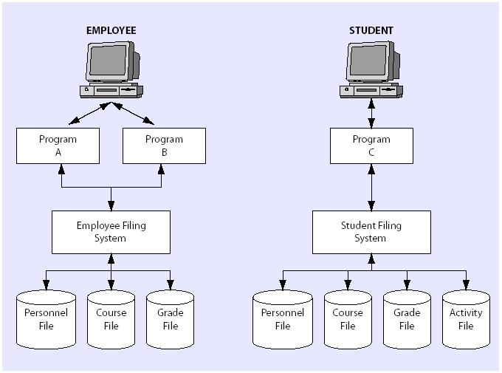
File Based Systems
A system of files and collection of application programs manipulating them is a file-based system
Programs that use these files have knowledge of the file format
University’s File-Based System

Slide 8
Limitations of File Based Systems
Program-Data Dependence
All programs maintain metadata for each file they use
Data Redundancy (Duplication of data)
Different systems/programs have separate copies of the same data
Limited Data Sharing
No centralized control of data
Lengthy Development Times
Programmers must design their own file formats
Excessive Program Maintenance
80% of information systems budget

Slide 9
Limitations of FBS: Program Data Dependence
Each application maintains its own data
Each application program needs to include code for the metadata of each file
Each application program must have its own processing routines for reading, inserting, updating and deleting data
Lack of coordination and central control
Non-standard file formats

Slide 10
Limitations of FBS: Data Redundancy
Waste of space to have duplicate data
Causes more maintenance headaches
The biggest Problem:
When data changes in one file, could cause inconsistencies
Compromises data integrity

Slide 11
Solution – Database Approach
Central repository of shared data
Data is managed by a controlling agent
Stored in a standardized, convenient form
Requires a Database Management System (DBMS)

Slide 12

http://www.thomasformo.com/category/qa/

